Slide 1

MGT1042 Investment Analysis and Portfolio Management
BY
SANJIL K C (20BCE1855)
TO FIND THE EFFICIENT BANK USING MACHINE LEARNING
REVIEW 1 and REVIEW 2

Slide 2
Decision Tree
Decision Tree Classification Algorithm
Decision Tree is a Supervised learning technique that can be used for both classification and Regression problems, but mostly it is preferred for solving Classification problems. It is a tree-structured classifier, where internal nodes represent the features of a dataset, branches represent the decision rules and each leaf node represents the outcome.
In a Decision tree, there are two nodes, which are the Decision Node and Leaf Node. Decision nodes are used to make any decision and have multiple branches, whereas Leaf nodes are the output of those decisions and do not contain any further branches.
The decisions or the test are performed on the basis of features of the given dataset.
It is a graphical representation for getting all the possible solutions to a problem/decision based on given conditions.
It is called a decision tree because, similar to a tree, it starts with the root node, which expands on further branches and constructs a tree-like structure.
In order to build a tree, we use the CART algorithm, which stands for Classification and Regression Tree algorithm.
A decision tree simply asks a question, and based on the answer (Yes/No), it further split the tree into subtrees.

Slide 3
How does the Decision Tree algorithm Work?
Step-1: Begin the tree with the root node, says S, which contains the complete dataset.
Step-2: Find the best attribute in the dataset using Attribute Selection Measure (ASM).
Step-3: Divide the S into subsets that contains possible values for the best attributes.
Step-4: Generate the decision tree node, which contains the best attribute.
Step-5: Recursively make new decision trees using the subsets of the dataset created in step -3. Continue this process until a stage is reached where you cannot further classify the nodes and called the final node as a leaf nod
Python Implementation of Decision Tree
Data Pre-processing step
Fitting a Decision-Tree algorithm to the Training set
Predicting the test result
Test accuracy of the result(Creation of Confusion matrix)
Visualizing the test set result.
.

Slide 4
Linear regression is one of the easiest and most popular Machine Learning algorithms. It is a statistical method that is used for predictive analysis. Linear regression makes predictions for continuous/real or numeric variables such as sales, salary, age, product price, etc.
Linear regression algorithm shows a linear relationship between a dependent (y) and one or more independent (y) variables, hence called as linear regression. Since linear regression shows the linear relationship, which means it finds how the value of the dependent variable is changing according to the value of the independent variable.
Linear Regression
Linear Regression

Slide 5

Mathematically, we can represent a linear regression as:
Here,
Y= Dependent Variable (Target Variable) X= Independent Variable (predictor Variable) a0= intercept of the line (Gives an additional degree of freedom) a1 = Linear regression coefficient (scale factor to each input value). ε = random error
Linear Regression Line
A linear line showing the relationship between the dependent and independent variables is called a regression line. A regression line can show two types of relationship:

Slide 6
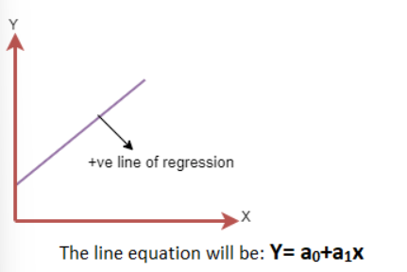
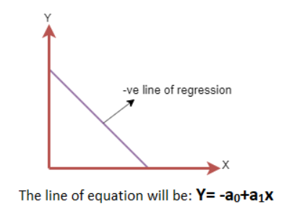
Positive Linear Relationship:
If the dependent variable increases on the Y-axis and independent variable increases on X-axis, then such a relationship is termed as a Positive linear relationship.
Negative Linear Relationship:
If the dependent variable decreases on the Y-axis and independent variable increases on the X-axis, then such a relationship is called a negative linear relationship.

Slide 7

THANK YOU

